Slide 1
Bash Scripting & Automation

Slide 2
Agenda
Introduction
Quoting & Expansion
Control Flow
Pipes, Redirection, Subshells
Globbing & Regex
Best Practices & Safety
Closing & Tasks

Slide 3
Introduction
Unix and GNU projects spread shells across systems; Bash became default on Linux, Zsh on macOS.
Zsh added themes and completion, Fish introduced autosuggestions, Nushell moved to structured data pipelines
Modern shells support cross-platform use (Linux, macOS, Windows via WSL), making scripting portable across environments.
sh
In 1977 by Stephen Bourne
Bash
1989 - Bourne Again
Zsh
sh started gaining popularity at early 2000s, introduced in 1990
Moderns shells
Late 2010s – Fish, Nu and NixShell
SHell.

Slide 4
Introduction: Bash
Default shell on most Linux distributions for decades.
Compatible with sh but adds arrays, functions, arithmetic, brace expansion.
Interactive + scripting: works both as a command-line shell and a programming language.
Many modern CI/CD pipelines (Jenkins, GitHub Actions, GitLab CI) still execute Bash scripts under the hood.

Slide 5
Quoting & Expansion
Quoting controls how the shell interprets text.
Single quotes ' ': literal text.
Double quotes " ": expands variables, command substitution.
Backticks / $( ): run a command inside another.
Parameter expansion: ${var:-default}, ${#var}, ${var%pattern}.

Slide 6
Quoting & Expansion cont...
Arithmetic expressions Use: $(( )) for integer math.

Slide 7
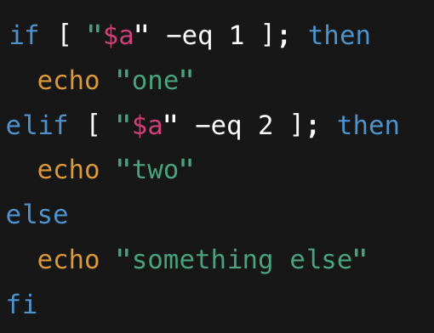
Control Flow
Scripts use conditionals and loops to automate logic.
Unlink conventional conditions, it's based on the exit status of test block
if / else, for, while, case.
Comparitors:
-eq, -ne, -lt, -le, -gt, -ge (numeric)
=, != (string)
Example: monitoring files, iterating over logs.

Slide 8
Control Flow
Much safer conditions with [[]] (extended test)
Supports regex, and directreference of variables withoutquotes.
(( )) (arithmetic evaluation)

Slide 9
Pipes, Redirection, Subshells
Redirection: >, >>, <, 2>.
Pipes: output → input of another command.
Subshells ( ) isolate environment.

Slide 10
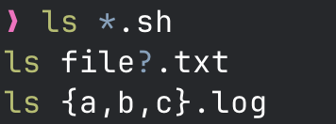

Globbing & Regex
Globbing (shell expansion): *, ?, [abc], {a,b,c}.
Regex used by tools like grep, sed, awk.
Key difference: globbing = filenames, regex = text patterns.

Slide 11
Best Practices & Safety
Always start with #!/usr/bin/env bash
Enable safe mode: set -euo pipefail
Quote variables "${var}"
Use functions to organize code.
Test scripts with bash -x
Keep scripts idempotent (safe to re-run).
Always Make sure to read the script before executing scripts from online.
Use > carefully. Prefer >| only if overwrite is intentional, or >> for append.

Slide 12
Pipes and Redirection

Slide 13
Thank You
Resources:
https://tldp.org/LDP/abs/html/index.html
https://aaltoscicomp.github.io/linux-shell/

